Slide 1
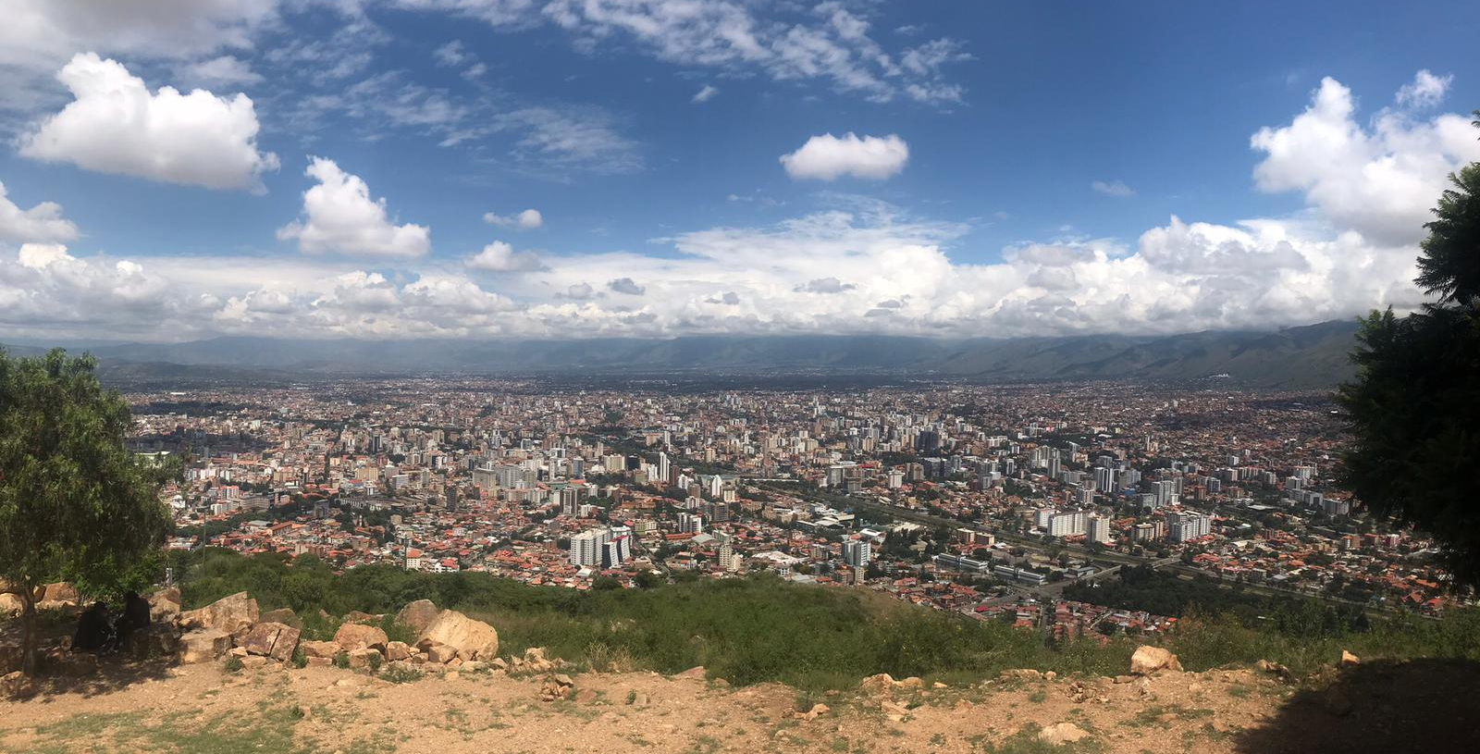
Analyzing neighborhoods in the US
Capstone Project 1 | Coline Zeballos
October 2019

Slide 2
Table of contents
Introduction
Data wrangling
Exploratory data analysis
Inferential statistics
Machine Learning
Conclusions

Slide 3



Problem statement
Predict the number of visitors in each CBG* each day and each hour
What are the most popular brands in a neighborhood?
Are there regional preferences for same brands over others?
At what time do people visit certain CBGs?
Restaurants, shops/stores, companies, mayor of a city could be interested to know which area attracts the most people to take decisions such as:
When and where do we need more/less public transportation?
What type of business to implement in which area?
Where to implement a new restaurant, shop strategically?
When to organize an event?
*CBG = census block group

Slide 4

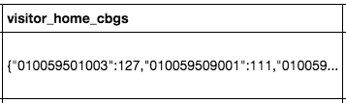
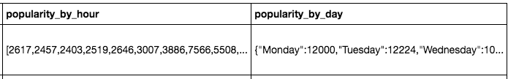

The data
Data source:
SafeGraph’s Open Census Data based on the US Census Bureau data
/!\ Problem /!\ A lot of work to get the data ready for analysis
perform sanity checks
split columns
remove NA rows
create additional columns (ratios, top 10 brands)
convert new columns to right type

Slide 5
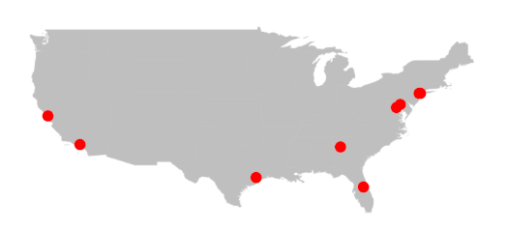
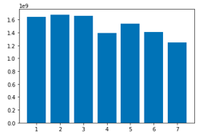
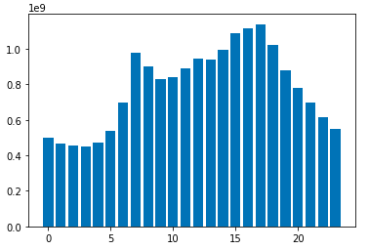
Initial findings
Top 10 most visited CBGs
Most visits: Tuesday
Least visits: Sunday
1. NY
2. NY
3. Los Angeles
4. Houston
5. NY
6. Atlanta
7. Washington D.C.
8. San Francisco
9. Washington D.C (Maryland)
10. Orlando
Most visits:
5pm
Least visits:
3am

Slide 6
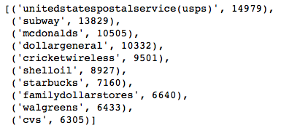
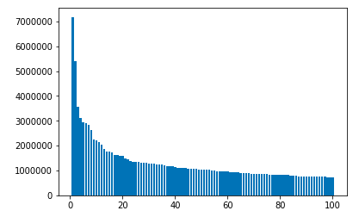
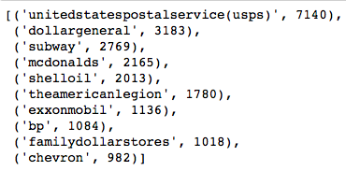
Initial findings
Top 100 most visited CBGs
Top 10 most visited brands during the week
85% of CBGs have a higher amount of visitors during the week (Monday toThursday) than during the weekend (Friday to Sunday)
Top 10 most visited brands during the weekend

Slide 7
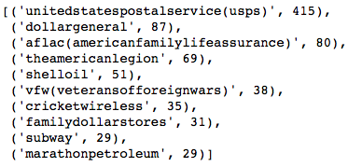
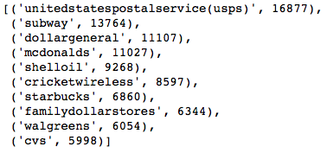

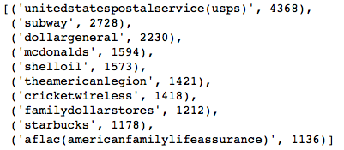
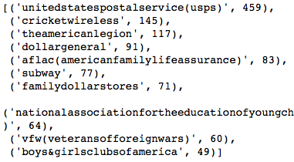

Initial findings
AM
PM
Top 10 most visited brands during early morning
Top 10 most visited brands during afternoon
AM
PM
Top 10 most visited brands during morning
Top 10 most visited brands during evening

Slide 8
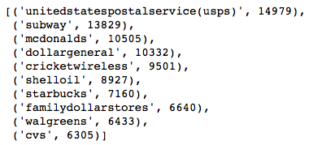
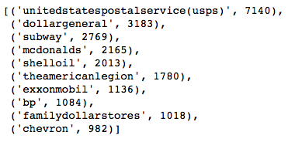
Initial findings
Most popular brands during the week (Monday to Thursday)
Most popular brands during the weekend (Friday to Sunday)

Slide 9
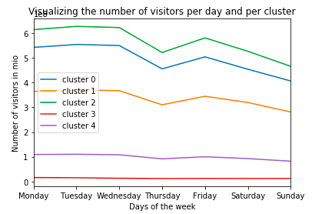
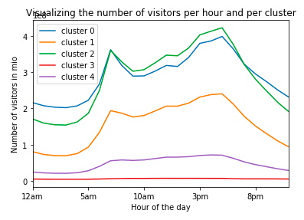
Clustering
Most populated days of the week: Monday to Wednesday
Thursday undergoes a clear decrease
Friday goes up again, but lower than the beginning of the week.
Sunday is the day of the week with the lowest number of visitors.
Peak at 7am, then down progressively until 9am
Second peak at 4pm
The number of visitors then decreases very quickly until 5am.

Slide 10
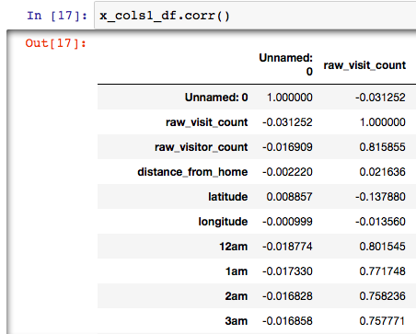
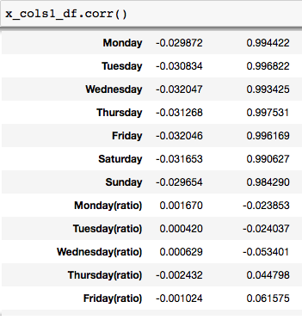
Checking correlations
Correlation between 'raw_visit_count' and variables representing popularity by hour
Positive correlation
Ok to use these variables in the model
Correlation between 'raw_visit_count' and variable representing popularity by day
Highly, almost perfect, correlation
Unexpected
Not ok to use these variables to predict the number of visitors in the model since they will not bring any additional information.

Slide 11
Building a predictive model
Cluster | R^2 | Representative Hour
Cluster 0 | 0.91 | 4pm
Cluster 1 | 0.72 | 5pm
Cluster 2 | 0.81 | 4pm
Cluster 3 | 0.59 | 1am
Cluster 4 | 0.46 | 8am
Interpretation:
To estimate the average number of visitors per month in each cluster, measuring the number of visitors during the unique representative hour identified for each cluster is representative.
These results coincidence with the predictive model’s using the decision tree method: all clusters had a peak hour at 7am then a higher one at 4pm.
Cluster 3 seems to be a bit different which can be explained by the small amount of CBGs present in this cluster.

Slide 12


To conclude
Project goals | Findings
What are the most popular brands in a neighborhood?
Are there regional preferences for some brands over others?
What time do people visit certain CBG?
Predict the number of visitors in each CBG/neighborhood each day and each hour
Additional questions that were answered:
Where are the most visited CBGs located?
What are the most popular brands during the week (Monday to Thursday), and during the weekend (Friday to Sunday)?

